Slide 1
CDR Corrections
Michael Sveiven, Blakeley Koziol, Adriana Barreda, Carissa Grijalva, Justin Hsieh, Timmy Shimmon

Slide 2
Part A: Brace Added to the System Block Diagram

Slide 3
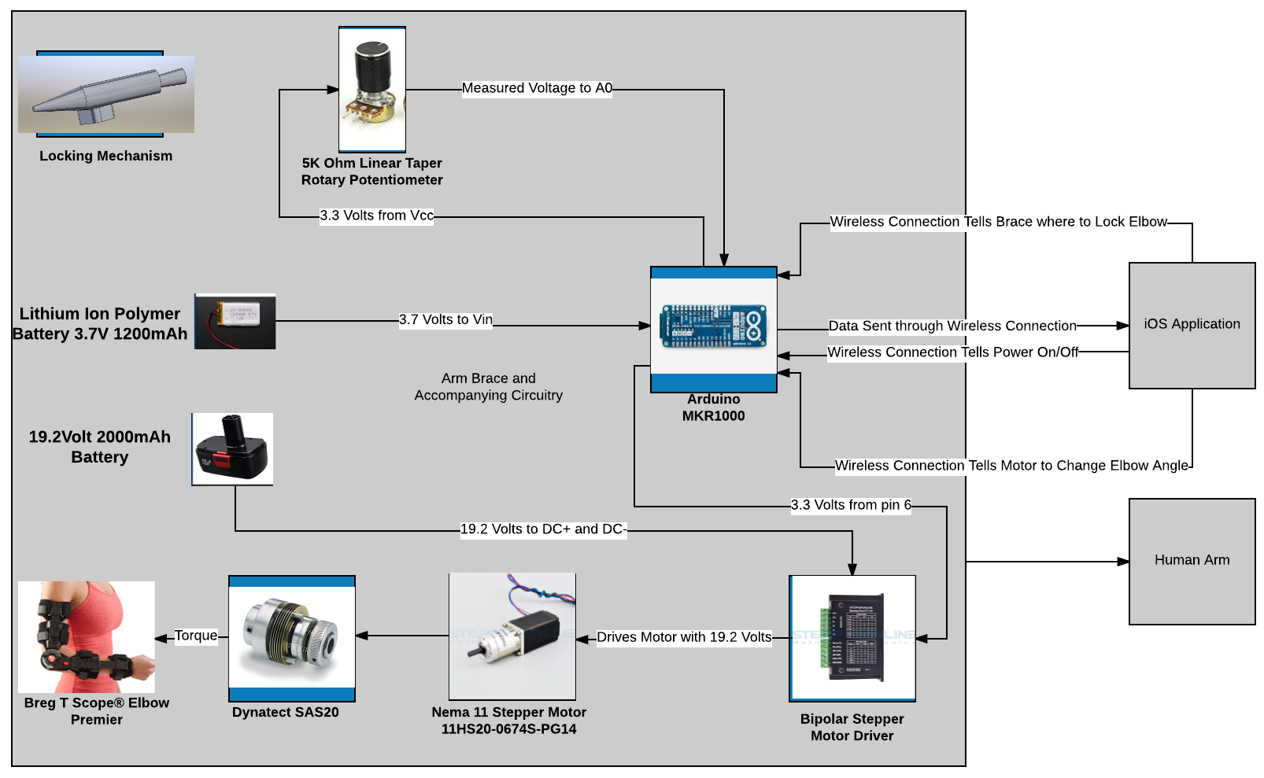
System Block Diagram

Slide 4
Part B: Design Details

Slide 5
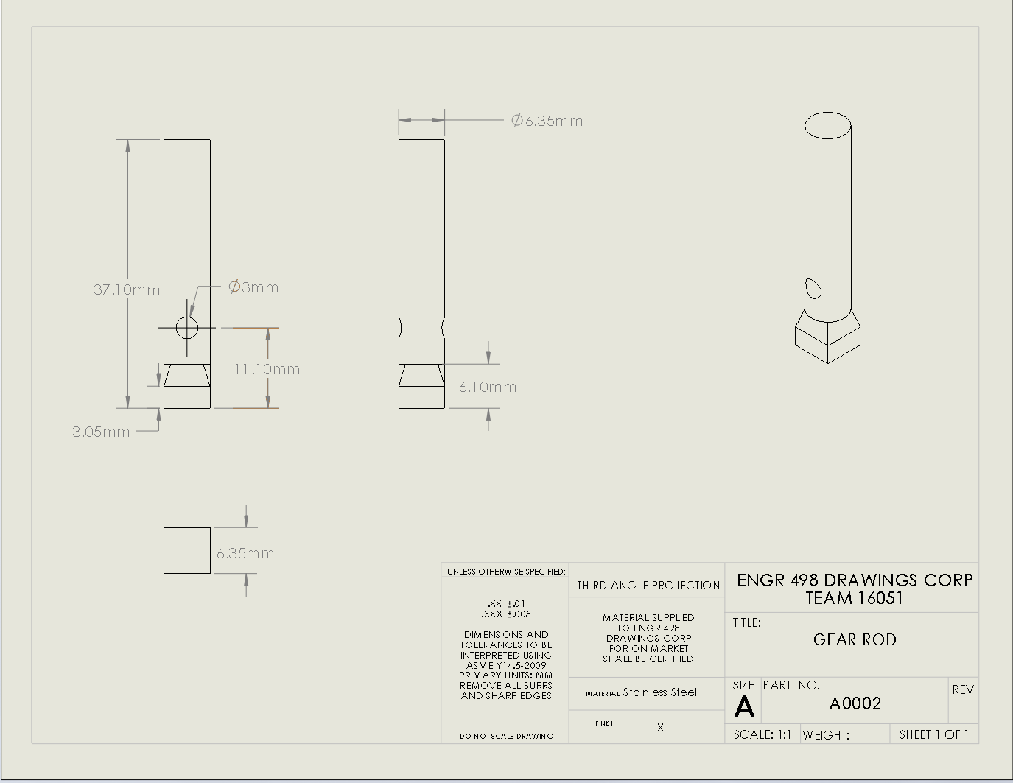
Holding Gear Rod
The holding gear rod will be created to hold the lower bevel gear. The bottom part has a square shaped protrusion to allow the mechanism to lock into the brace; having flat surfaces allows a more stable force torque onto the forearm section of the brace. The hole located at a 11.10 mm level will be used to add a set screw across to stabilize the bevel gear.

Slide 6
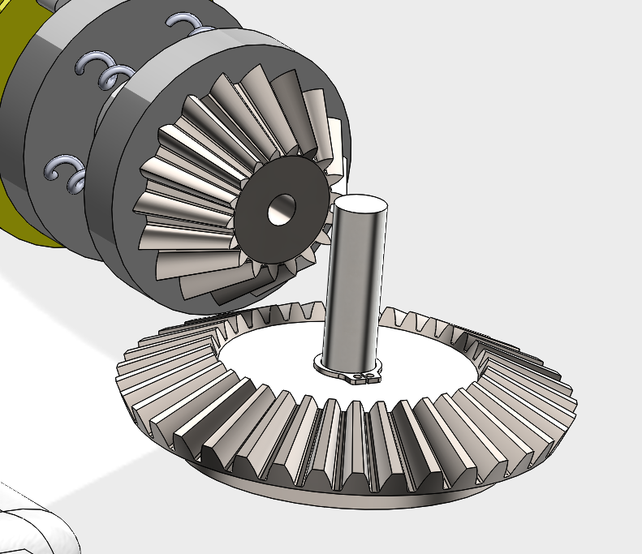
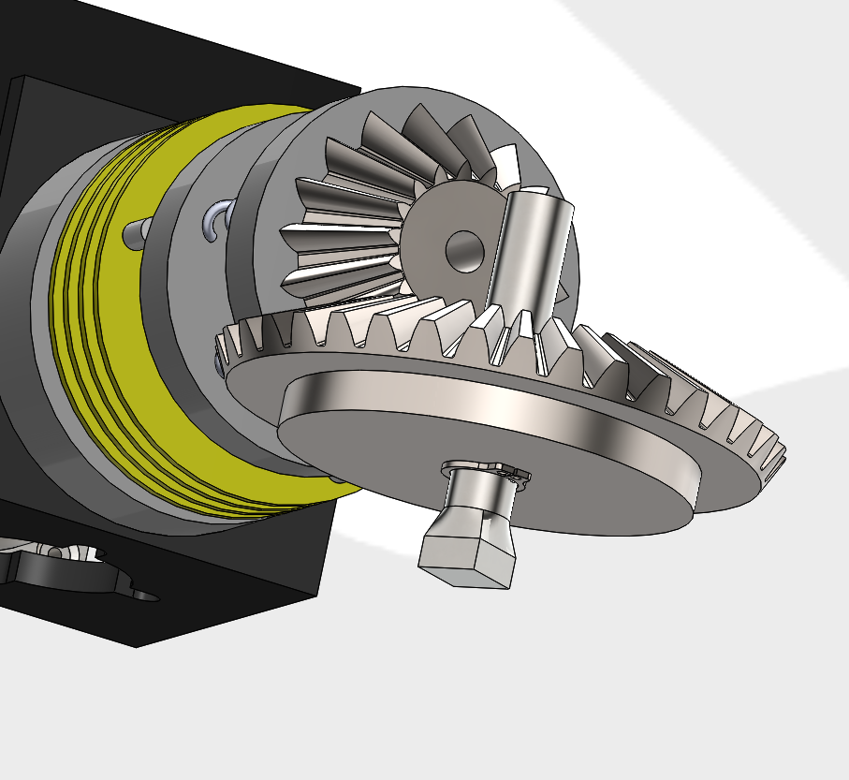
Gear Mounting Assembly

Slide 7
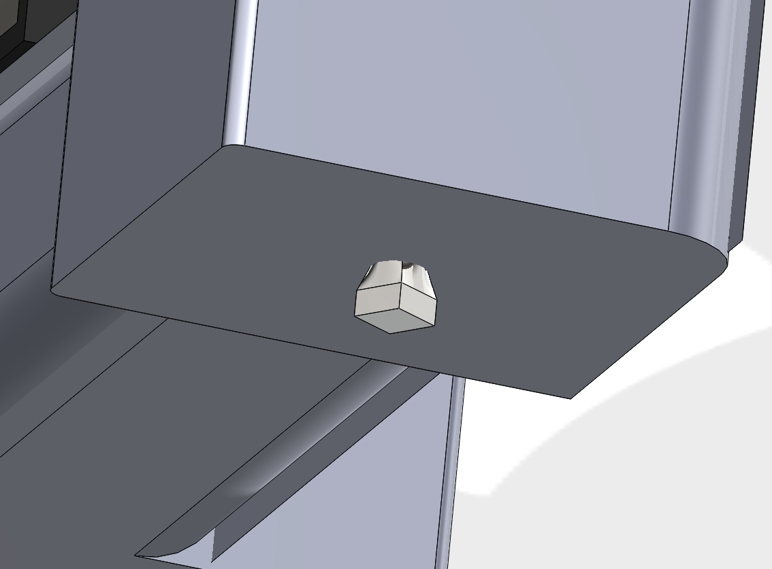
Gear mounting assembly
In the figures of the assembly from past slide and this one, we show how snap rings and set screw (not shown) allow the gear to be positioned in place. In this figure shown how the case encloses the rest of the shaft, leaving only the part that is going to be attached to the brace.

Slide 8
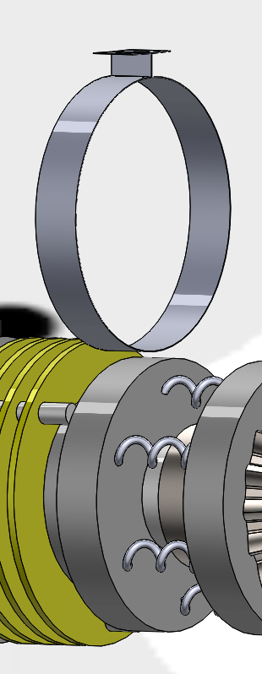
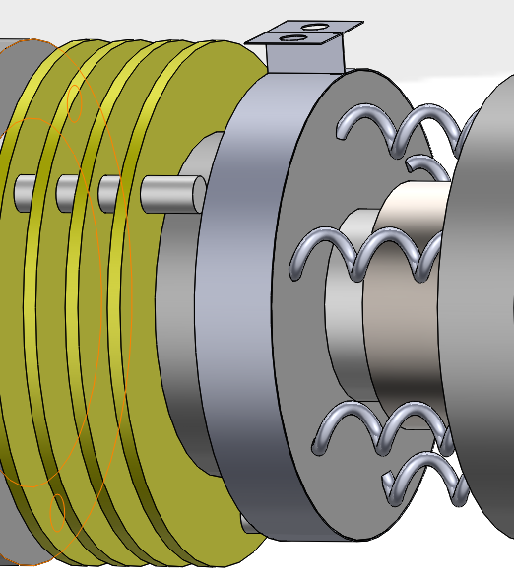
Mounting Piece
Addition of snap ring with holes for screws
Stabilizes clutch with the case but connects at a point on the clutch that will still allow it to “slip”

Slide 9
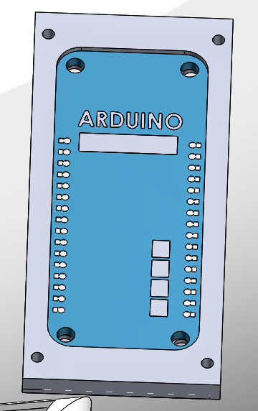
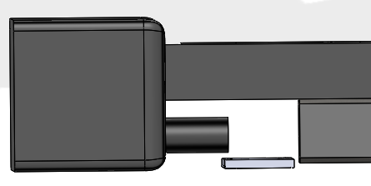
Mounting Piece
Arduino mounting case
Will be fixed to the bottom of the case to allow for connections/wires with adequate room and prevention of overheating

Slide 10
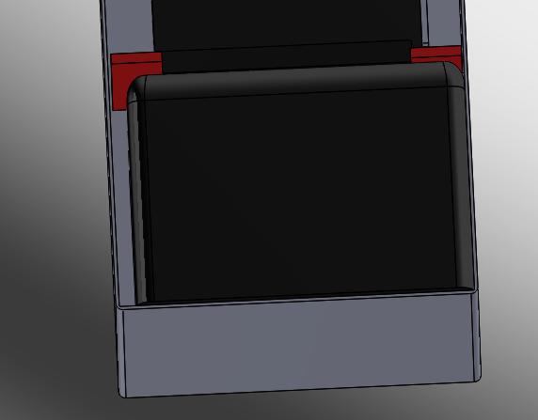
Stabilizer
Dividers (indicated in red) will hold the battery in place to stabilize if from shifting forward or back.
The case will also stabilize the battery from the bottom and the top

Slide 11
Part C: Test Procedure Additions

Slide 12
Test Procedure Verification: Battery Life (9.0)
Procedure:
Attach the 19.2V battery, motor, and casing unit onto the brace, and power the device on via the iOS application
Program the device to flex from 0˚ to 150˚ and to extend from 150˚ to 0˚
Perform this movement as many times until the battery is completely dead
Use an iPhone timer to determine the duration of battery life. Begin the timer as soon as the first flexion movement begins. Battery life should last at least an hour
The device shall flex and extend to complete one cycle, and a total of 20 cycles should be completed before the battery dies
Record the number of complete cycles that occur on the data sheet
If the device completes at least 20 cycles in the battery life, it passes the test

Slide 13
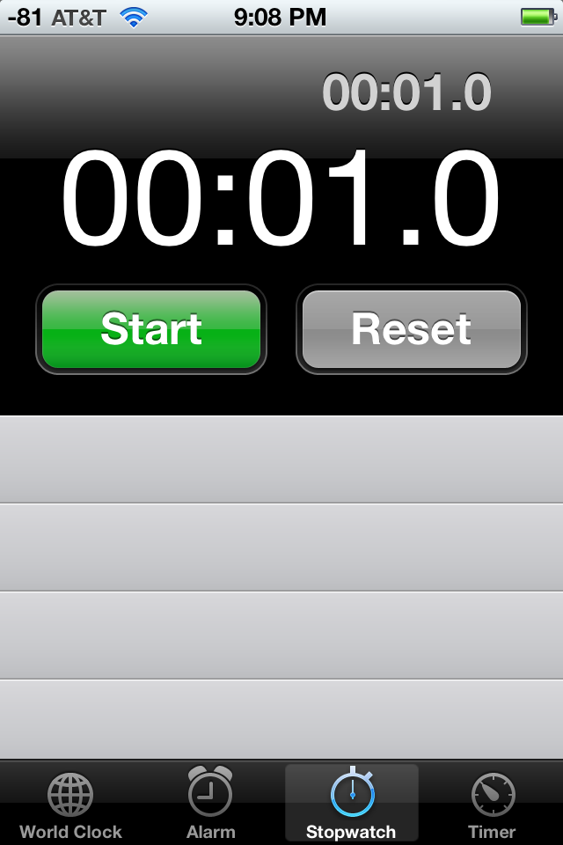
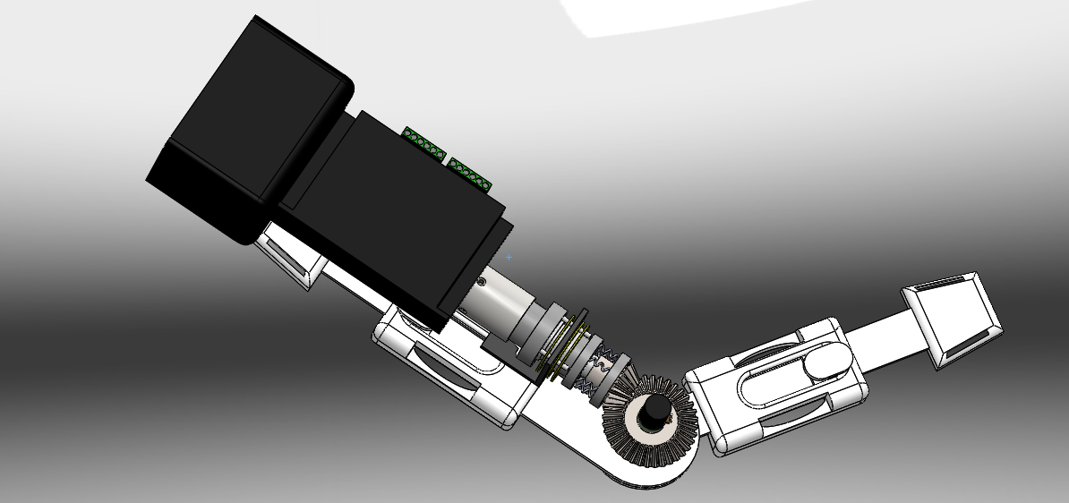
9.0 Battery Life: Data Sheet
DI-NDTI- 80603-T9
Date:__________
Contractor:______________________
Pass, or why failed: _________________________
Requirements:
The battery shall withstand at least 20 cycles in its lifetime
The battery life shall last at least an hour
Recorded Values:
Cycles until battery dies: ____________________
Time of battery life: ________________________
Test Errors:
Limit Calculation:
Expected Results: The battery will last a duration of at least 20 cycles in at least an hour
iPhone timer
0˚ to 120˚
120˚ to 0˚

Slide 14
Test Procedure Verification: Battery Recharge (10.0)
Procedure:
Run the 19.2V battery until it is completely dead.
Plug the battery into the charging dock in the nearest outlet
Using an iPhone timer, time the duration it takes for the battery to be fully recharged
Battery recharge time should take less than 5 hours for the device to pass

Slide 15
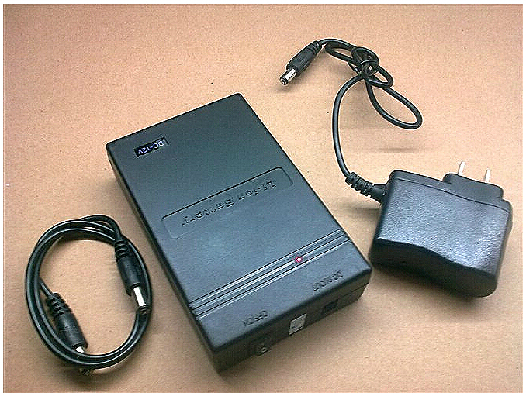
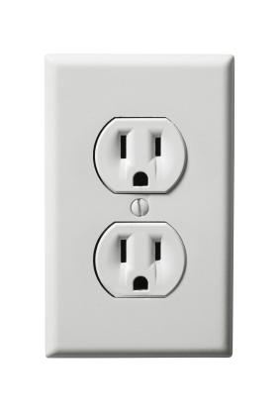
10.0 Battery Recharge Data Sheet
DI-NDTI- 80603-T10
Date:__________
Contractor:______________________
Pass, or why failed: _________________________
Requirements:
Battery recharge from completely dead to fully recharged shall take less than 5 hours
Recorded Values:
Battery recharge time: _______________________
Test Errors:
Limit Calculation:
Expected Results: The battery will recharge in less than 5 hours
Timer should read less than 12 hours

Slide 16
Part D: Tolerance Analysis

Slide 17
Models and Analyses
Models and Outputs Definition
Requirement | Model | Tool
3.2.4 Position Tolerance | Angle Tolerance | Excel
Model | Tool | Inputs | Output
Angle Tolerance | Excel | Elbow Angle, Desired Angle | Position Tolerance

Slide 18
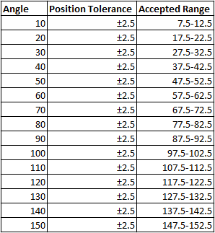
Tolerance Model
The brace shall stop and change direction within 2.5 degrees of the desired elbow angle
This table shows the accepted range for some of the most commonly desired elbow angles

Slide 19
Part E: Cost Corrections

Slide 20
Production Estimates
There were an estimated 150,000 elbow surgeries in US in 2006.
In response, estimated number of AEO devices to be produced in the span of the first 6 months would be 10,000 to observe sales and competition. After this production will be adjusted accordingly. These estimates were made in theory and are not permanent.

Slide 21
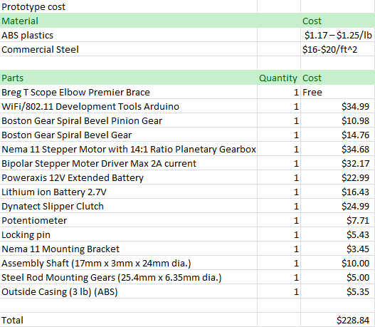
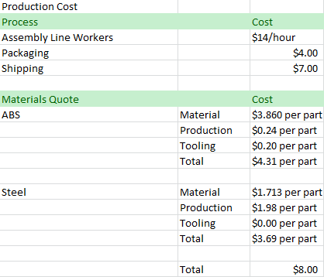
Prototype and Assembly
The following is an estimation of the cost of the AEO prototype and assembly cost.

Slide 22
Cost of AEO Device and Profit
Current braces in the market with no active assist range from $300 to $600. In the future our portable device would be competitive at a price ranging from $700 to $1000 with the downloadable iOS application free of cost. At the moment, the prototype cost would be valued around $400.

Slide 23
Item | Cost Ea. | Qty. | Supplier | Lead Time | When Needed
Arduino | $34.99 | 1 | Arduino LCC/ Amazon | Obtained | 2/2
Potentiometers | $7.71 | 5 pc. | Amazon | Obtained | 2/2
Stepper Motor (including gear box) | $34.68 | 1 | StepperOnline Motors and Electronics | Obtained | 2/2
Arduino Battery | $16.43 | 1 | Amazon | 1 week | 2/2
Motor Battery | $22.99 | 1 | Amazon | 1 week | 2/2
Brace | Free | 1 | Sponsor | Obtained | 2/2
Stepper Motor Driver | $32.17 | 1 | StepperOnline Motors and Electronics | 5 days | 2/2
Slipper Clutch | $24.99 | 1 | Dynatect | 1 week | 2/2
Boston Gear Spiral Bevel Gear | $14.76 | 1 | Amazon | 1 week | 2/2
Boston Gear Spiral Bevel Pinion Gear | $10.98 | 1 | Amazon | 1 week | 2/2
Casing | $5.35 | 1 | UA Machine Shop | 2-3 weeks | 3/1
iOS Application Student Consultant | ~$1000 | - | - | - | -
Team Shirts | $50 | 6 | Aztec Embroidery | 2 weeks | 3/10
Design Day Poster | $20 | 1 | University of Arizona | 2 weeks | 4/20
Total | $1,525.05 | - | - | - | -
Misc. | ~10% | - | - | - | -
Extended Cost | $1,677.55 | - | - | - | -

